Slide 1


Slide 2
Land Acknowledgment
Interfaith Action is located on the traditional and contemporary lands of the Dakota people, who have lived here since time immemorial. Despite centuries of colonial theft and violence, this is still and will always be Indigenous land. We honor the ancestral stewards of this land and celebrate their past, present, and future.

Slide 3
Mission
We mobilize diverse faith and spiritual communities to engage in work that supports our neighbors’ stability and economic mobility

Slide 4
Vision
Opportunity grows and poverty recedes when people of faith invest themselves in effective action

Slide 5
How it started
1906 – Ramsey County Sunday School Association
1943 – St. Paul Council of Churches
1962 – St. Paul Area Council of Churches
2015 – Interfaith Action of Greater St. Paul
Notes:
There’s a good narrative history of our work published in 2006 to celebrate the Centennial of the St. Paul Area Council of Churches
1906 – Ramsey County Sunday School Association, emphasis on Protestant education & leadership development for religious instruction release days
1943 – St. Paul Council of Churches, expansion beyond Protestant Sunday School education/leadership services to include charity, social services work, and ecumenism among Protestant denominations and with Catholic parishes/entities
1962 – St. Paul Area Council of Churches; growth of metro area, ongoing social service needs, legislative advocacy, broad-based religious organizing
2013 – intentional discernment period to recognize growing economic needs of neighbors in St. Paul, successes of historic SPACC anti-poverty programs of Department of Indian Work and Project Home, and the need for all religious people to be part of the solution; broadened the constituency to include people of all religious backgrounds, and narrowed the programmatic focus to mobilizing faith community volunteers against systemic poverty through direct service
2015 – Interfaith Action of Greater St. Paul – needed ED with expertise in anti-poverty work, wasn’t an ordained/commissioned/religious professional, wasn’t Christian, and understood the critical role religious commitments play in activating people to make their community a better place to live. The Board chose Randi Ilyse Roth, a career-long legal aid lawyer working with people around affordable housing and farming disputes and eventual director at the Otto Bremer Foundation before she came to Interfaith Action. She was also raised and continues to live out her Jewish faith through her local synagogue, Beth Jacob Congregation, in Mendota Heights

Slide 6
How it's going
2017 – Opportunity St. Paul
2019 – Day Center addition to Project Home
2020 – COVID pivots for DIW & PH
21/22 – Building the Beloved Community Public Safety Project
2022 – Economic Mobility Hub
Notes:
Guiding question: How can we mobilize people of faith to build an infrastructure of opportunity in our community?
Based on the strengths of Project Home and the Department of Indian Work, created Opportunity St. Paul, Community Power Ups & Power-Up legal clinics, and built partnerships with civic leaders
Sold building at 1671 Summit, operating out of Provincial House and Department of Indian Work locations and remotely

Slide 7
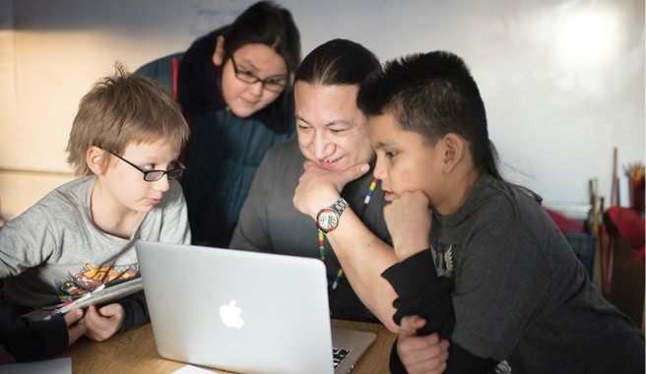
Department of Indian Work
Emergency, Referral, Education, Economic services for Indigenous families
Notes:
We partner with American Indian families to revitalize culture, education and wellness. We provide a safe, Indigenous space to empower families towards self-determination, while respecting cultural and spiritual diversity.

Slide 8
Program Areas
Emergency services
Diabetes education
Youth enrichment
MDH COVID Community Coordinator
Economic Mobility Hub
Notes:
Emer: FY21: served 2,500 individuals representing 52 tribal nations, providing over 189,000 lbs of food—mostly delivered via Indige-van until recently!
First culturally-specific foodshelf to become Supershelf site in MN
Diabetes: Partner with U of MN on family education diabetes services (FEDS), food demonstrations, prevention and maintenance at a variety of locations (indoor/outdoor)
Enrichment: 100 youth participate in culturally-relevant curriculum of after school and summer programming, learning Indigenous history, arts and ceremony; literacy; physical health; and taking field trips
Connect callers to resources: COVID-19 testing, vaccine clinics, housing, food, and health.
Host vaccine and testing events
Metro Transit ads
Shared human services data system between DIW, American Indian Family Center, and Montessori American Indian Childcare Center, built by and for the American Indian families, in partnership with consultant Nicole Martin-Rogers
“No wrong door”
Intentional connections, purposeful referrals, and navigation

Slide 9
Past, Present, Future
1952 – Department founded under SPACC
1968 – Department centralized under MCC
1973 – Department decentralized by MCC
2019 – Need more space
2021 – We got more space!
Notes:
Begun in 1952 as Twin Cities American Indian Ministries (See LCE with Cris Stainbrook on Indigenous land loss and precipitating factors that led to need for urban emergency services)
Short shuffle history 1968-1973 as MCC
Outgrew space at previous location on Summit Ave., Expanded to new, larger location in Little Canada
Partnership with Native-led nonprofits (American Indian Family Center and to realize American Indian Community Center Collaborative on the East Side

Slide 10
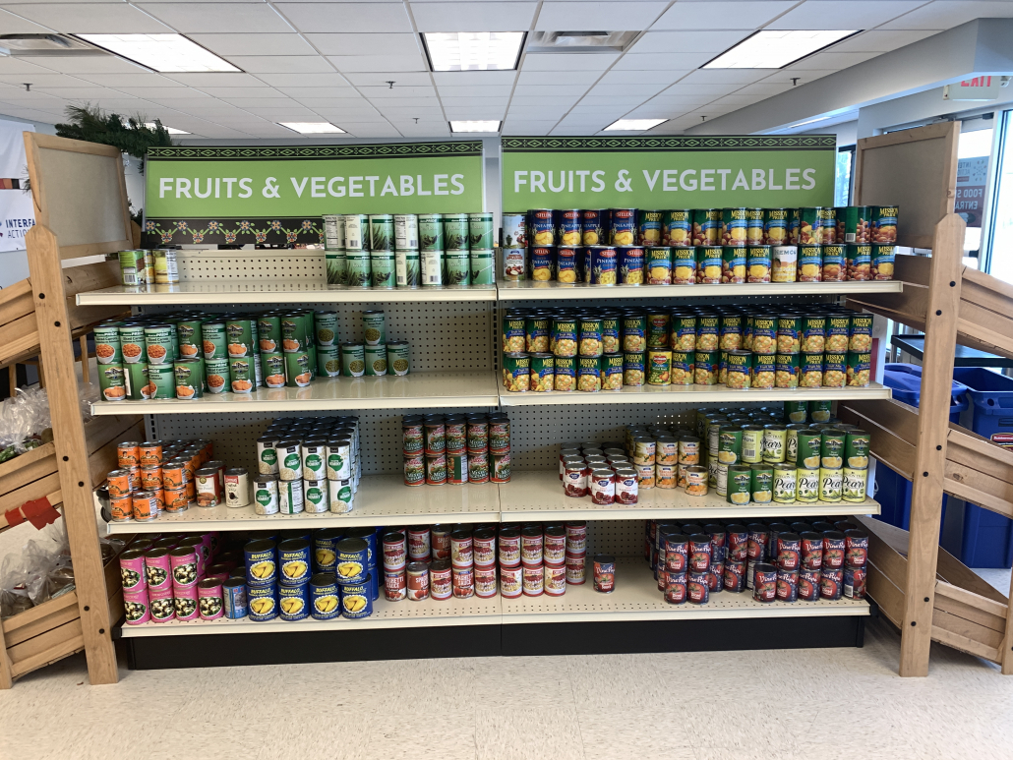
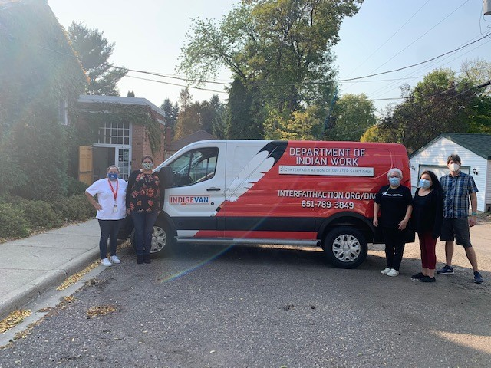
New Location, New Van
3080 Centerville Road, Little Canada

Slide 11
American Indian Community Center Collaborative

Slide 12
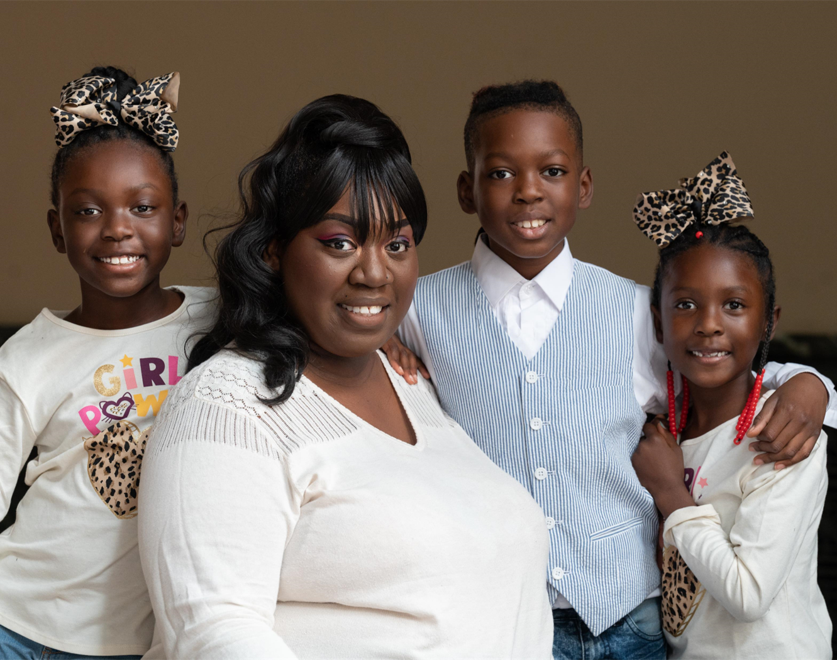
Project Home
Transitional housing services for families experiencing homelessness
Notes:
Transitional housing services for families at the Provincial House, in partnership with Ramsey County and the Sisters of St. Joseph of Carondelet

Slide 13
Program Areas, Old and New
Transitional Housing
Day Program
Comprehensive Case Management
Education Services
Notes:
FY21: beds slept in 23,074 times (63% increase from previous year), by 239 children (85% 12 or under) and 153 adults, serving 121 families
FY21: 22,488 meals served, along with twice daily snacks
In past year, average stay fell from 83 to 66 days!
Employment, housing, budget/savings plan
FY21: on average, families left shelter with just over $1,000 in savings
At present, 94% of families who left shelter report current housing is stable
6 months of resource referral aftercare by case management staff
Project REACH hosting Pre-K – 3rd grade onsite summer school 3 times a week
Project REACH provides onsite tutoring for all grades during the school year

Slide 14
Past, Present, Future
1998 – Program begins
2000 – Two congregations per month
2018/19 – Day program and rapid exit case management
2020-2021 – Shelter-in-place shuffle
2021 – Shuffle ends at Provincial House
2022/beyond – More services!
Notes:
Mobile shelter rotating among houses of worship, staffed primarily by volunteers
2019: Addition of day center and rapid exit case management
The COVID pivot: sheltering in place lead to Provincial House
Capacity: 40 beds to 80 to 100 beds!
Nursing undergrads for wellness checks, literacy tutors
Securing longer-term funding to maintain services
Partnerships with St. Kate’s, Allina nurses doing wellness visits, SPPS

Slide 15
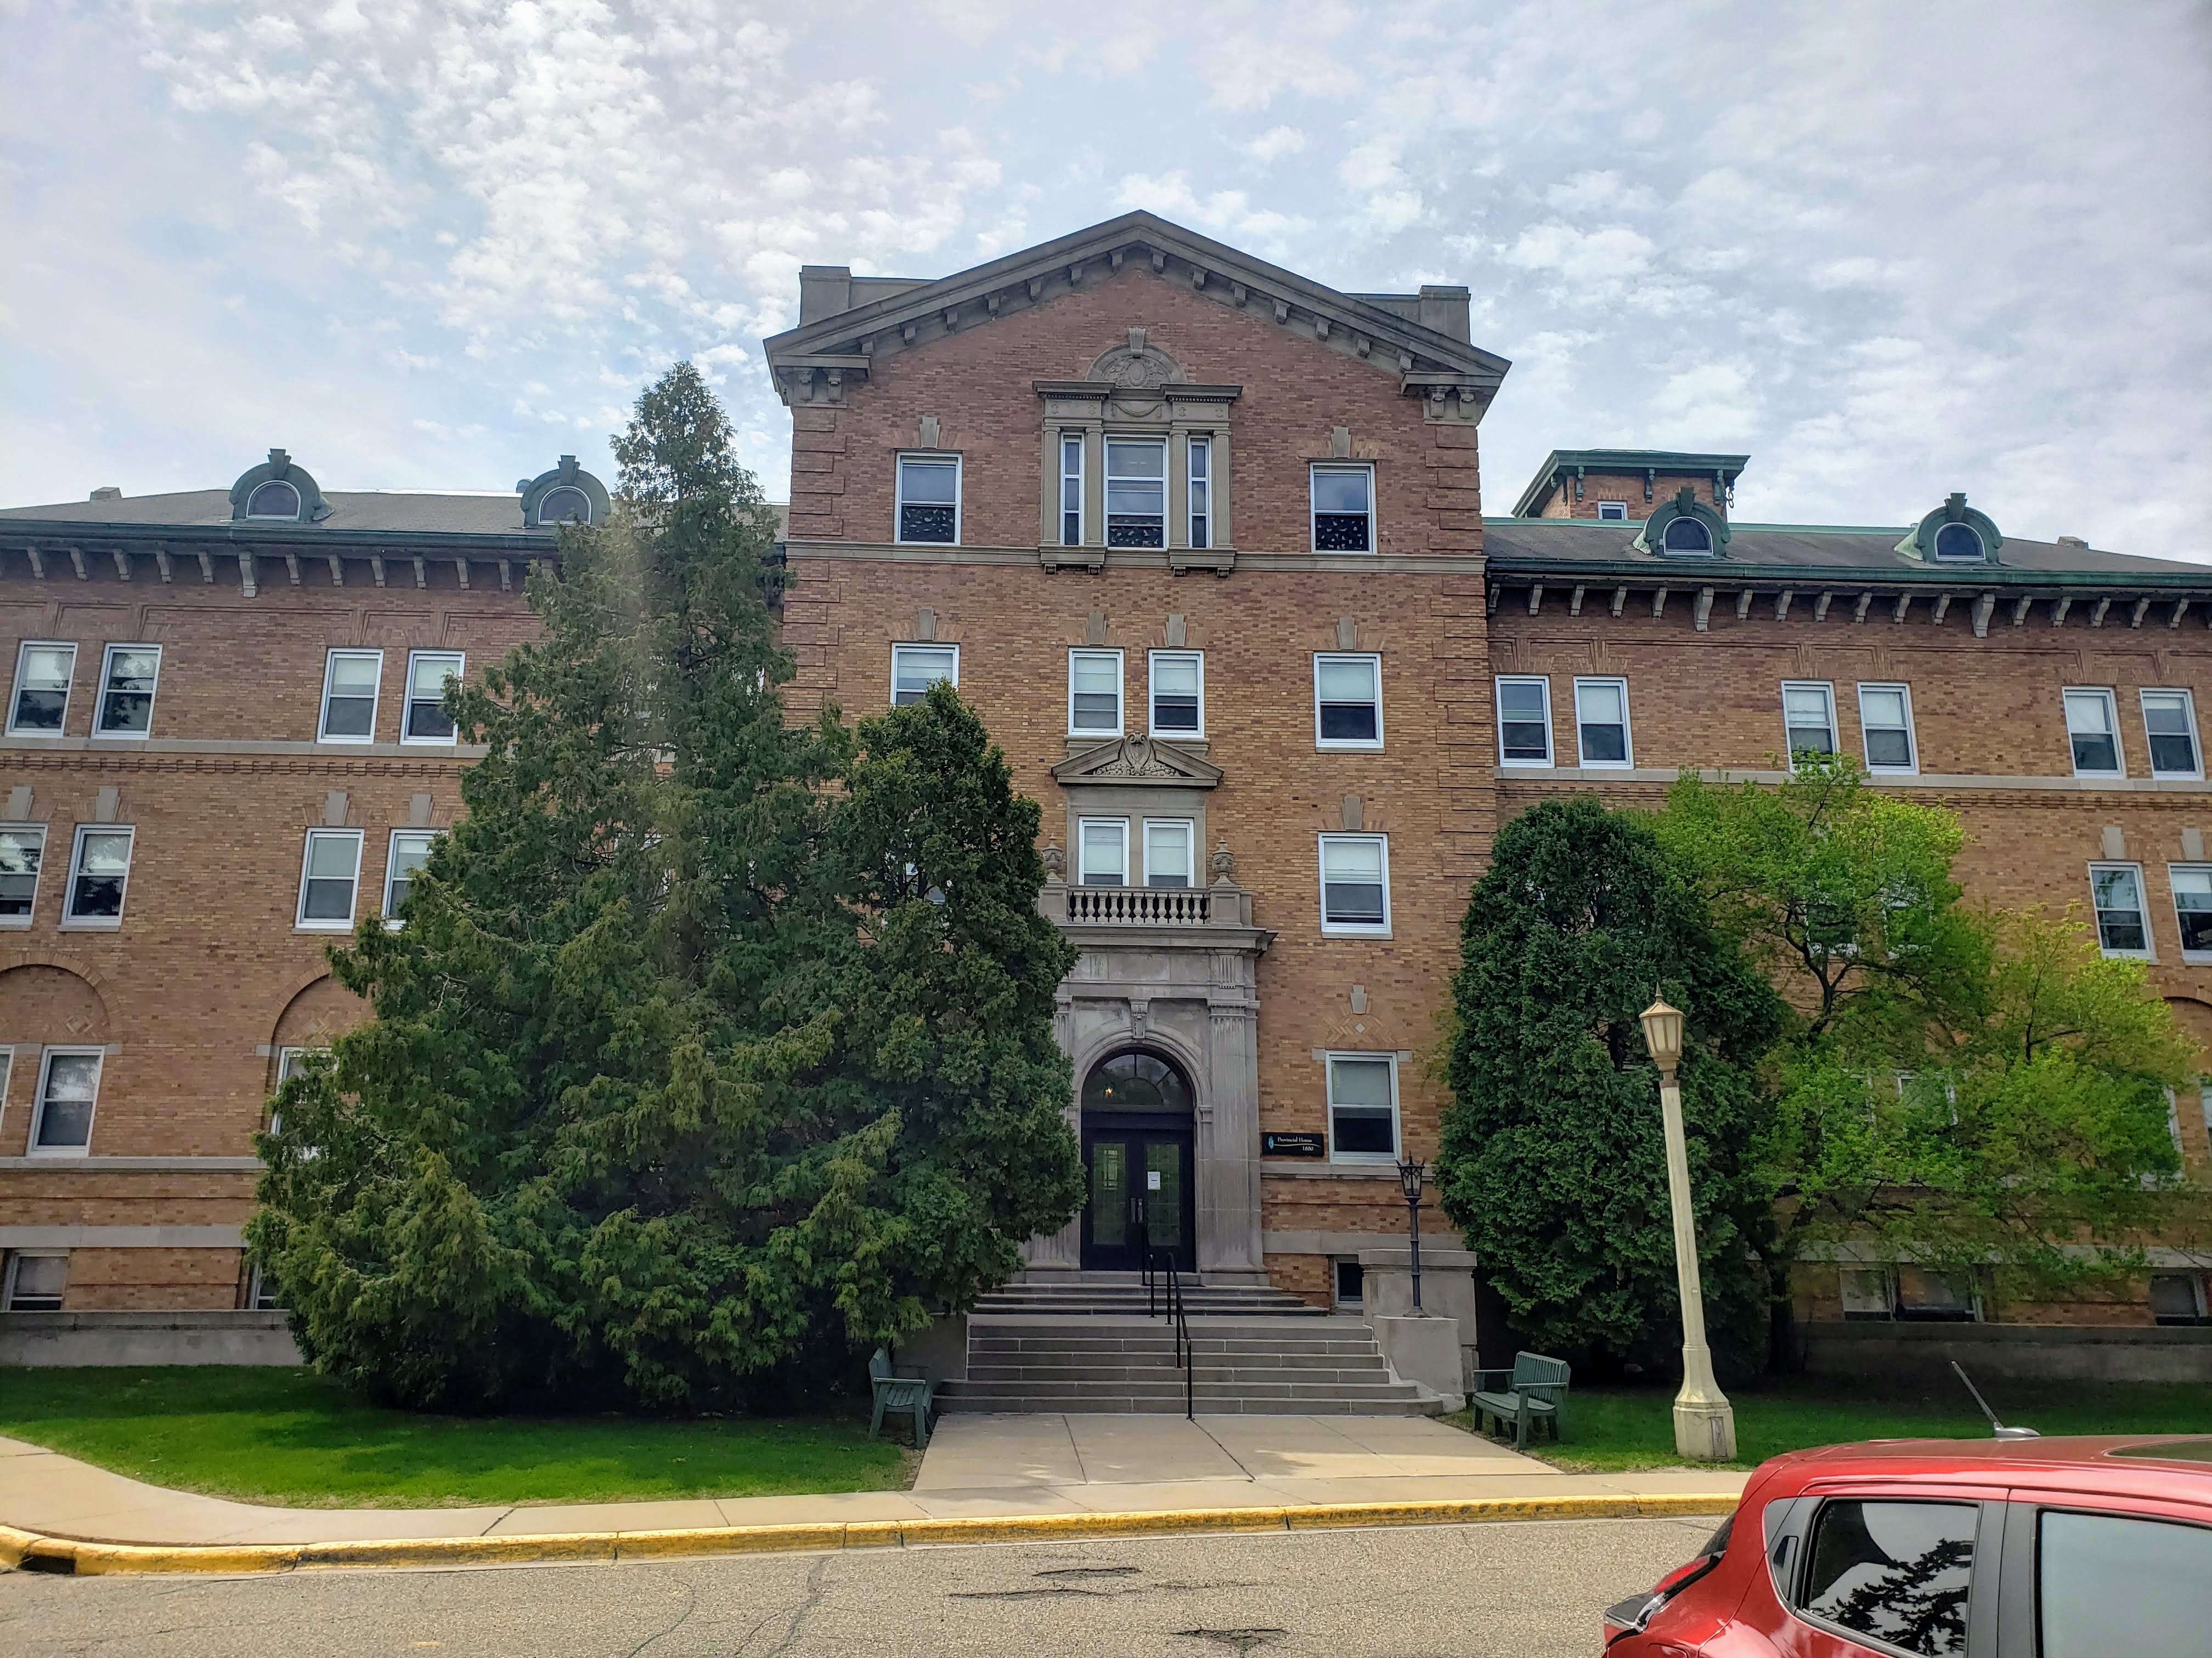
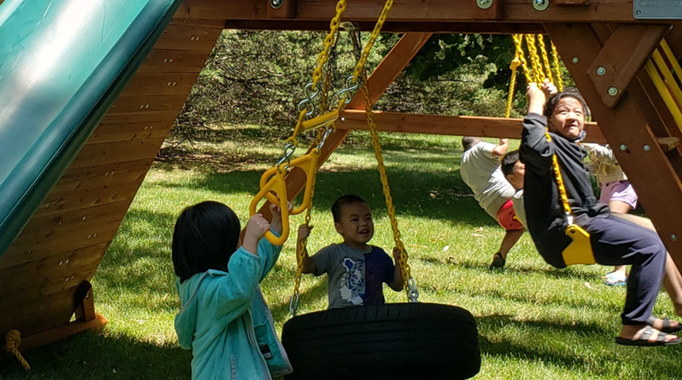
Provincial House Location

Slide 16
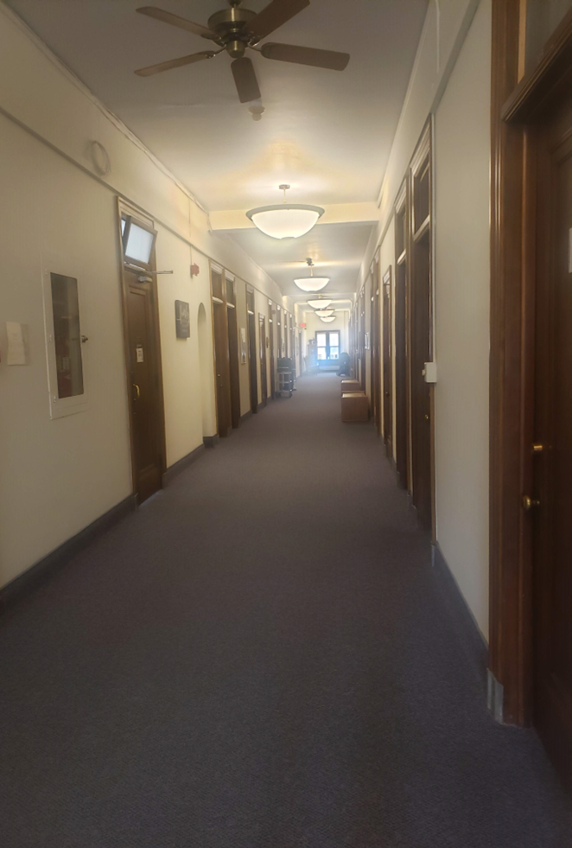

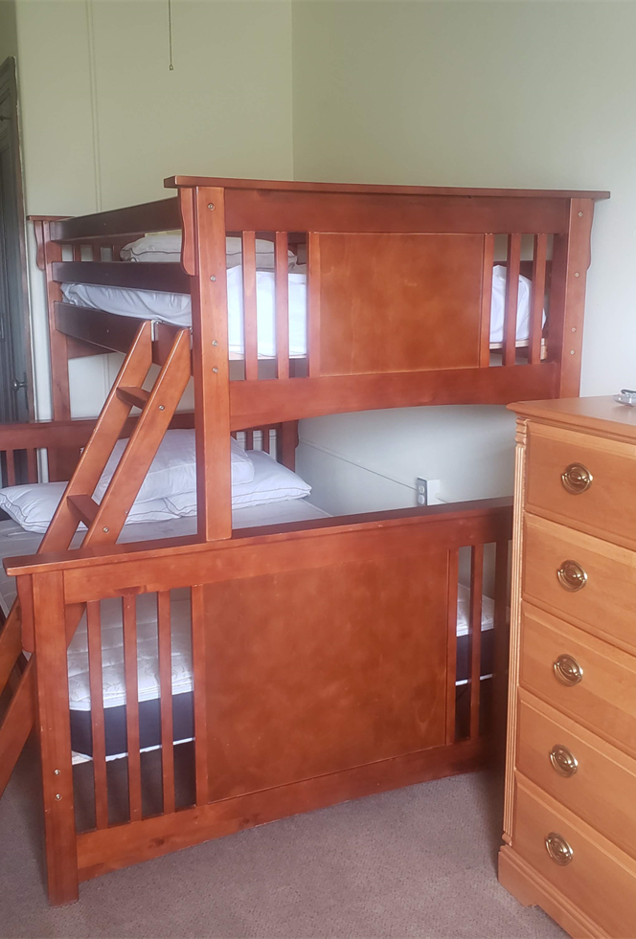
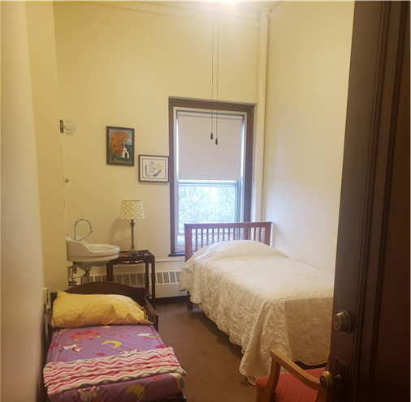
Provincial House Location

Slide 17
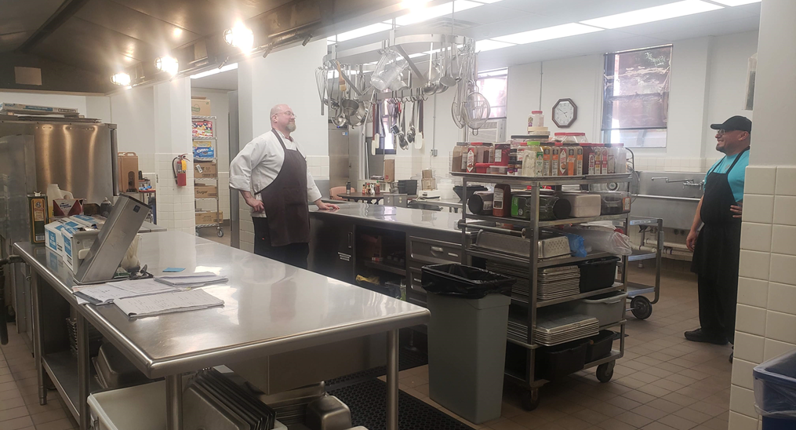
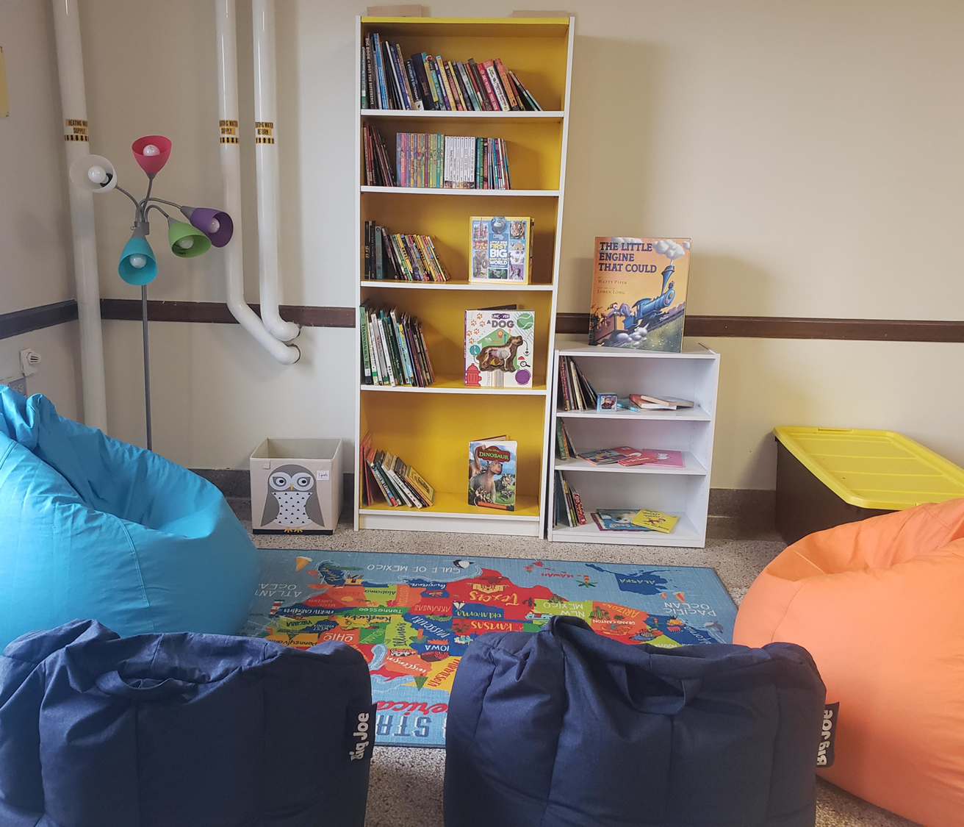
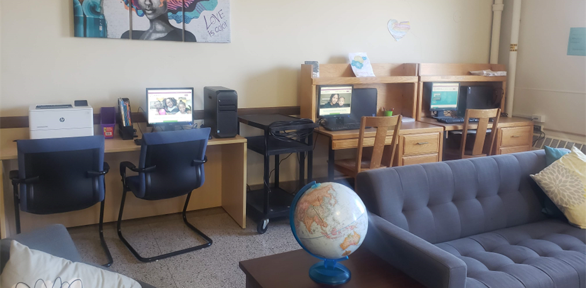
Provincial House Location

Slide 18
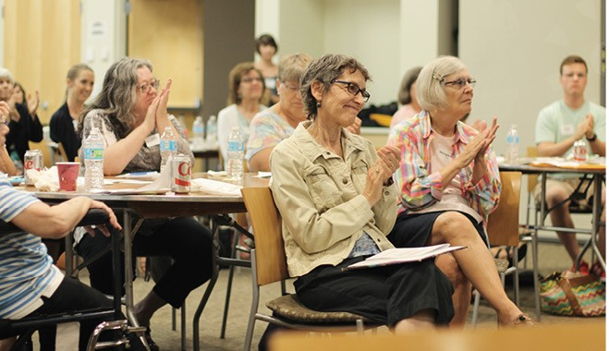
Opportunity Saint Paul
Volunteer placements with high-impact nonprofits
Notes:
High-impact weekly volunteering with proven partners, and engagement opportunities that advance understanding for lay and clergy leaders

Slide 19
Programs & Partners
Project Home
Department of Indian Work
CommonBond Communities (Study Buddies)
Daily Work (job coaching, resume building)
East Side Learning Center (in-school tutoring)
Neighborhood House (tutoring/teaching assistance)
Reading Partners (in-school tutoring)
St. Paul Public Library (drop-in homework help)

Slide 20
Past, Present, Future
2016 – Expand on successes of Project Home
2017 – Launch with 80+ volunteers & 7 partners
2020 – LCEs around racial justice
2021/22 – Public safety project
Notes:
Where can volunteers have the best chance for positive impact, and be invited to transform from “helper” to extended family in the process?
Community-led process to determine most effective nonprofit partners→Focus on increasing likelihood for achieving post-secondary education credential to maximize labor market potential
Provide dynamic learning events that deepen understanding, erode judgment, and encourage empathy
Clergy civic engagement opportunities with city, county, and state-wide leaders to improve community relations
Re-visioning with community partners to build toward becoming volunteer hub for faith communities

Slide 21
Learning Community Events
Personal & Structural Barriers to economic stability & mobility
“Six degrees of segregation”
Mass incarceration and restorative justice
American Indian land tenure
Navigating an inhumane human services system
Trauma-informed care
Motivational interviewing
Children’s health during/post-COVID
Poverty simulation
Unconscious bias

Slide 22
Clergy Civic Engagement
Conversations with civic leaders
Planning commission direction
De-polarizing and informing
public safety
Notes:
State-wide conversations with Dept. of Public Safety Commissioner John Harrington and 38 houses of worship, bringing religious values to the task of building a better public safety system
Faith leaders developed textual source books for Buddhist, Christian, Jewish, and Unitarian traditions
Informing funding and policy recommendations in the Commissioner’s conversations with the legislature and upcoming budget proposals
Forthcoming third-party evaluation with analysis and recommendations from world-renowned evaluation team
Building cross-congregational collaborations for ongoing engagement of public safety issues

Slide 23
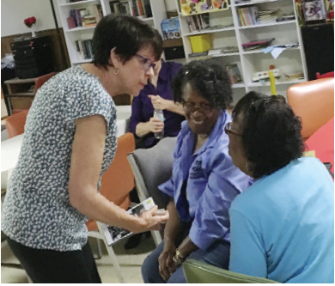
Community Power-Up/Legal Clinic
Bringing legal and financial expertise into the neighborhood
Notes:
Community presentations and free walk-in legal assistance, provided in collaboration with Southern MN Regional Legal Services, the Cardozo Society, and Progressive Baptist Church

Slide 24
Legal services
Landlord/tenant or property issues
Divorce, parenting time, custody, or other family law issues
Debt collection
Impounded car
Criminal record expungement
Purchase or service contracts
Probate
Employment
Simple wills and health care directives
Other civil legal matters (just not criminal law)

Slide 25
Past, Present, Future
2015 – Conversation with Pastor Walker
2016 – First Community Power Up
2017 – Expand to Walker West
2020/21 – Legal rights videos
2022 – Reopen in-person legal clinic
Notes:
Outreach from Pastor Carl Walker at Morning Star Baptist Church
What would be the impact if everyone in underserved areas of our community knew all their legal rights, and had access to expert services?
Pre-COVID: operating out of Walker West Music Academy
During high COVID: Legal rights videos, and online and phone services during COVID
Current site at Progressive Baptist Church offers in-person and phone assistance
In conversation with other legal groups beyond the Cardozo Society to provide another site and set of lawyers ready to serve more individuals

Slide 26
Get Involved!
Volunteer!
Notes:
Every success our families realize happens because they’ve met supportive neighbors like you;
Neighbors who show up for tutoring and meal prep and foodshelf assistance;
Neighbors who show up and are fundamentally changed by the encounters and relationships across differences;
Neighbors who show up to say, YIMBY, Yes In My BackYard, for Project Home at the Provincial House; for legal clinics in your house of worship; for an American Indian Community Center Collaborative to be worthy of all of the federal, state, county and city money that has been stolen from Indigenous people for centuries.
There are so many ways to be involved in social change work; it all needs our attention and commitment. But I’m reminded of the recent words of civil rights attorney Fred Gray, a man Dr. King referred to as the chief counsel of the civil rights movement. As a still-practicing attorney at the age of 91, after receiving the presidential medal of freedom this past summer, Mr. Gray reflected on his decades-long participation in the struggle for equal rights by saying, “We have changed the laws but we haven't changed the attitudes behind the persons who are enforcing those laws.” Attitudes won’t be changed without encounter, without relationship, without the routine practice of being present to and working alongside our neighbors who have been locked up and left out.

Slide 27
www.interfaithaction.org
Rev. Phillip Romine
promine@interfaithaction.org | 651-661-9350

